Slide 1

Craving! Web Application
Architecture Type: Application Architecture
View: Logical View
Style: Layered Architecture Pattern
Users Delivery Channels Core Business Processes Data & Information Technology Enablers
Authentication
Login Data
Real-time Event Bus
Account Profile
User Data
E-Payment
Mobile Device
Subscription Management
Account Data
Email
Internal User
Checkout
Orders Data
B2B-Gateway
Support
Payment Data
Payment Data
Internet Browser
External User
Product Review
Filter Data
Protocol Transformation
Internal Management
Products Data
Message & Service Routing

Slide 2

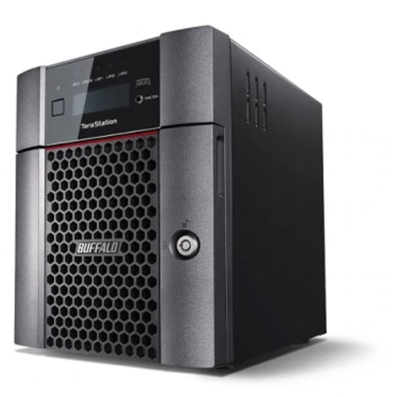
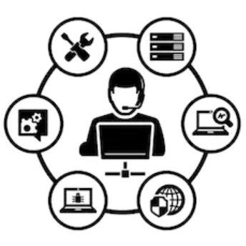
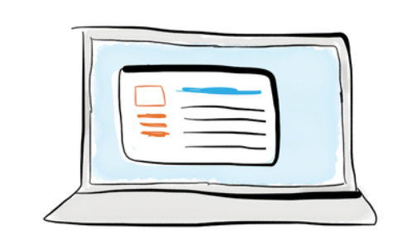


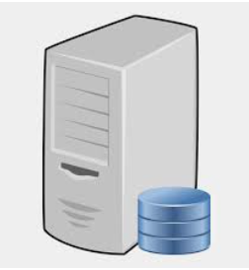
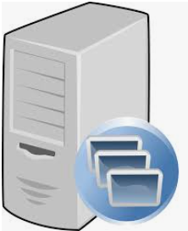
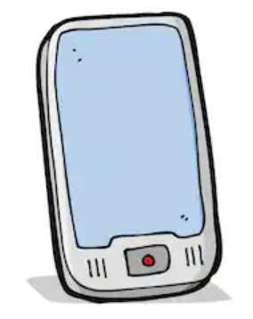
Craving! Web Application
Architecture Type: Application Architecture
View: Process View
Style: Client-Server Pattern
Firewall
Internal Users
NAS Server
Internet
External Users
Web Server
App Server
DB Server

